Slide 1
TDT4265 Project Presentation
Sivert Utne
Notes:
welcome to my presentation

Slide 2
1.1 Dataset exploration
Notes:
First lets have a quick look at the data we are working with

Slide 3
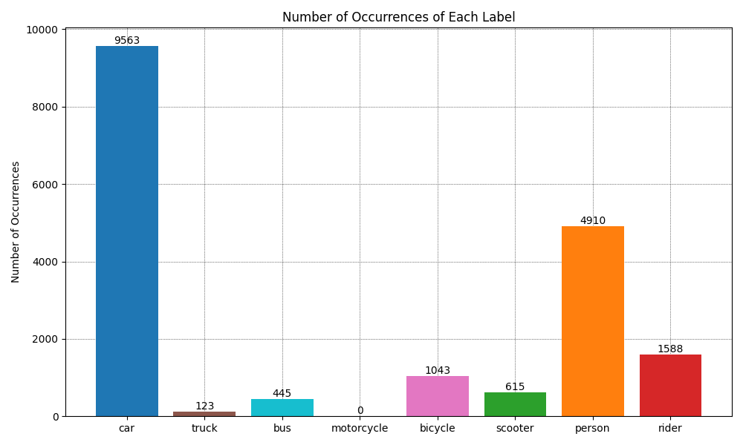
1.1 Dataset exploration – Classes Train (original)
Notes:
Here we see the original training dataset, which is used to train all the models except the final one.
moslty cars, then persons

Slide 4
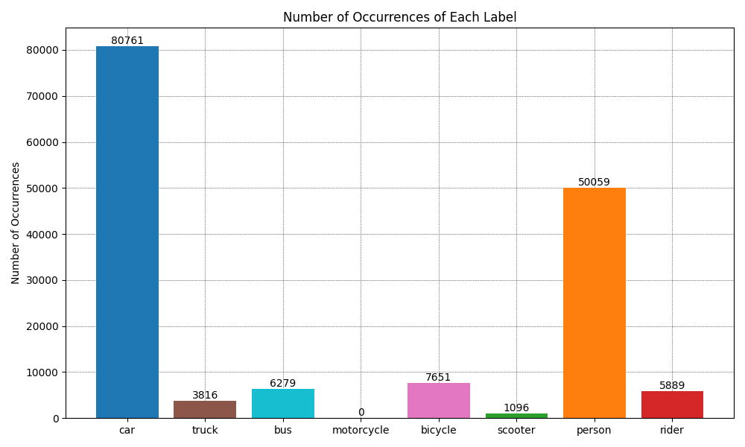
1.1 Dataset exploration – Classes Train (Updated)
Notes:
Distribution is very similar for the extended/updated dataset, but now obvoiusly with a lot more occurences

Slide 5
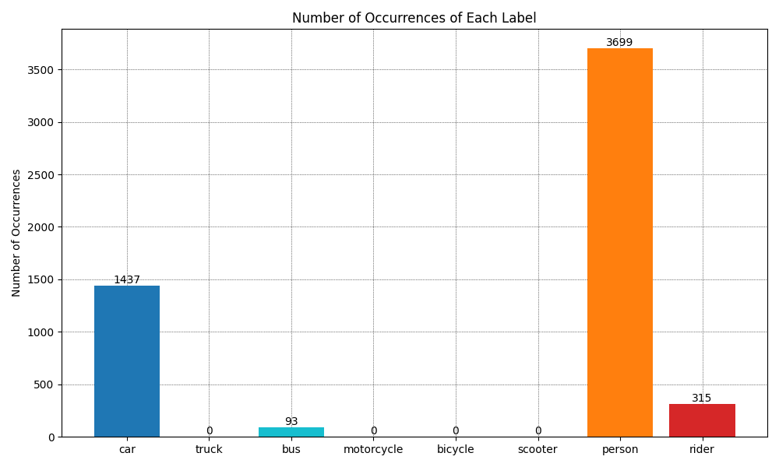
1.1 Dataset exploration – Classes Validation
Notes:
Validation dataset is quite different from the training dataset in regards to what is present, we see for instance that only 4 classes are present, and now there are more than twice as many persons as cars. This isnt a huge deal, but it means the netowrk will train on mostly cars, can validate on mostly persons

Slide 6
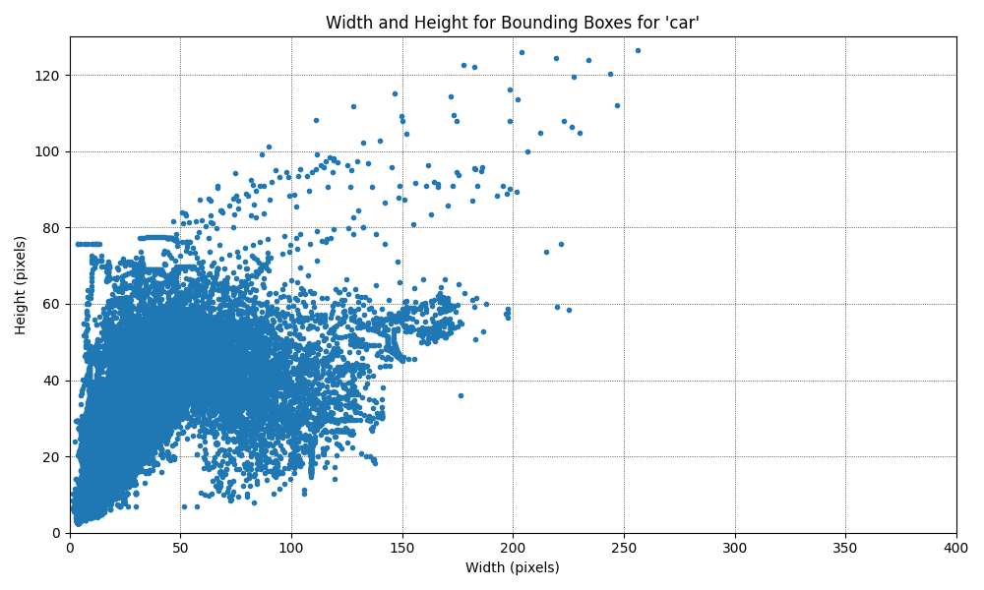
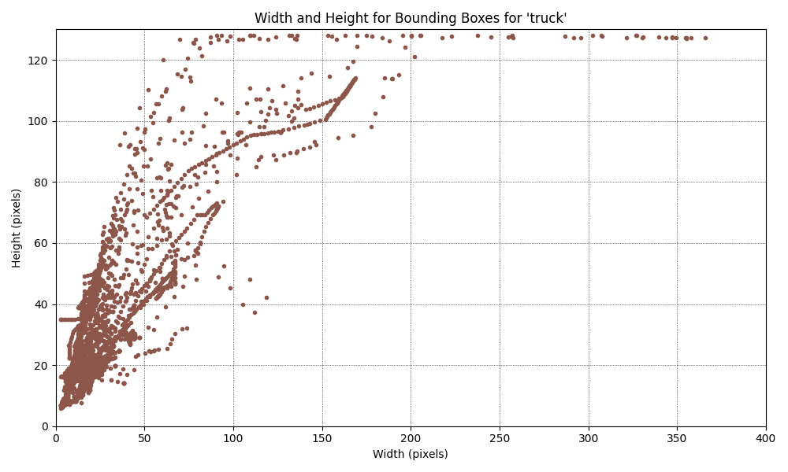
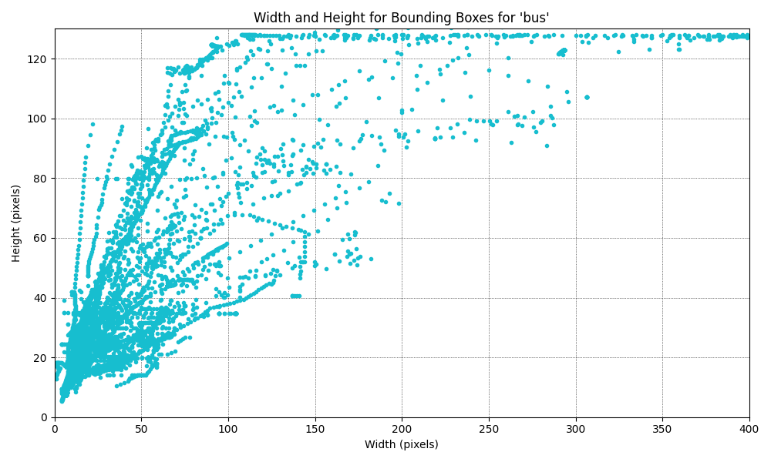
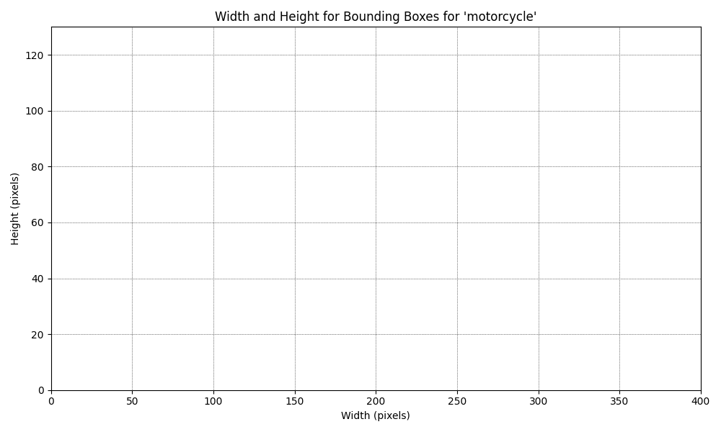
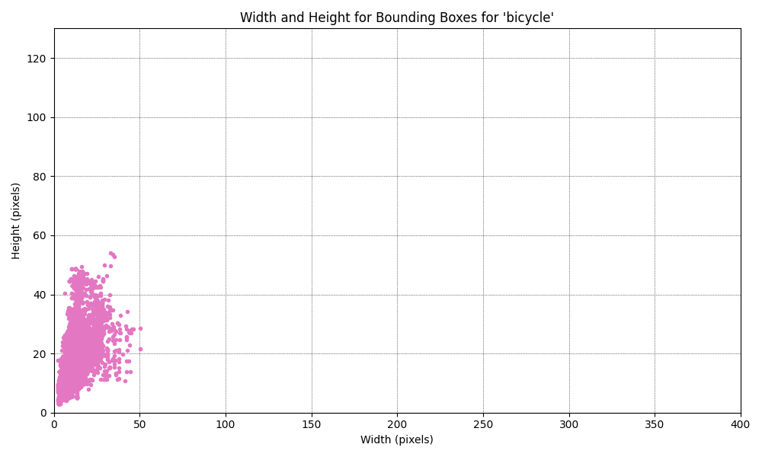
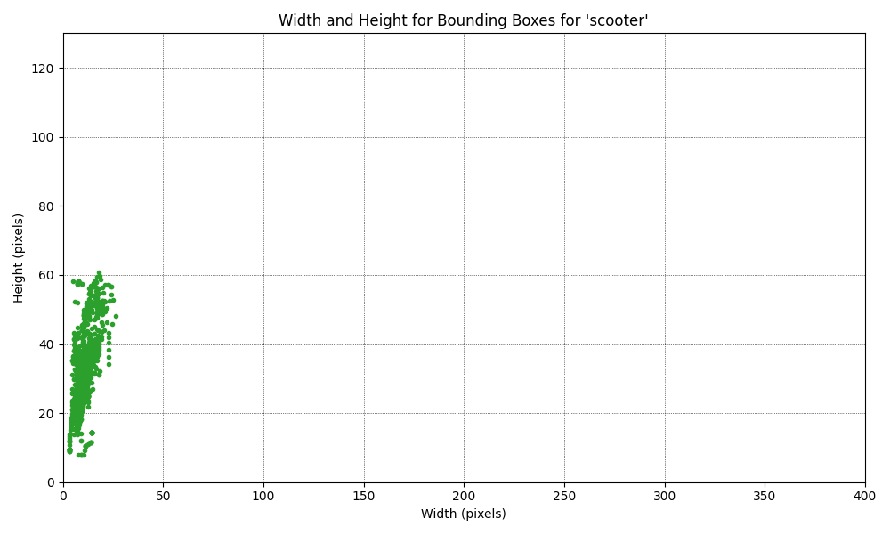
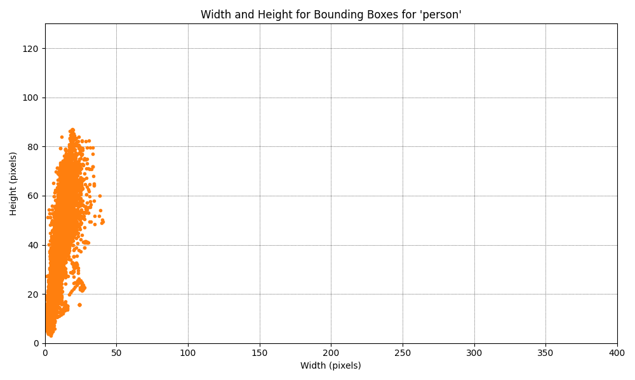
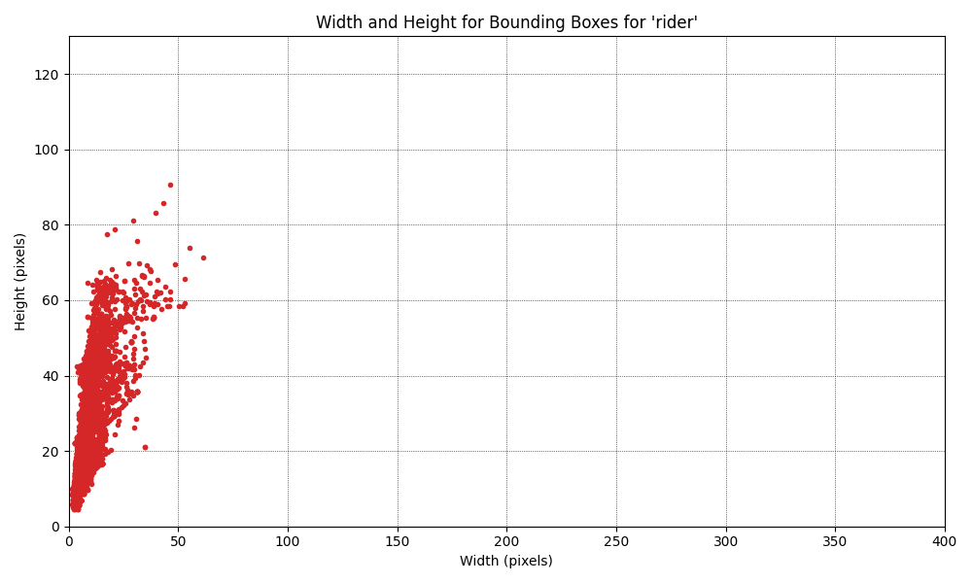
1.1 Dataset exploration – Sizes from updated training dataset
Notes:
noe lets look at the sizes of the bounding boxes for each label, we notice perticuarly that cars tricks and busses (top row) are mostly square or tall, while the bicycles, scooters, persons and riders are exclusively tall narrow boxes, this will be important later.

Slide 7
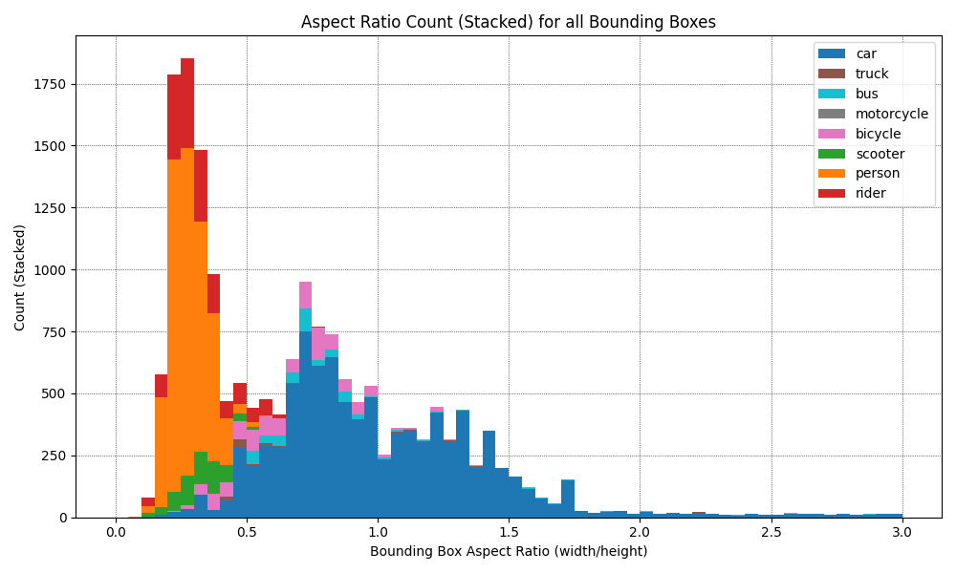
1.1 Dataset exploration – Aspect ratio train (Original)
Notes:
Now if we combine all of these sizes and find their aspect ratios, we get the following distribution, again this is the original training dataset and wee see almost all aspect ratios are below 2, meaning almost all bounding boxes are tall and narrow, or square.

Slide 8
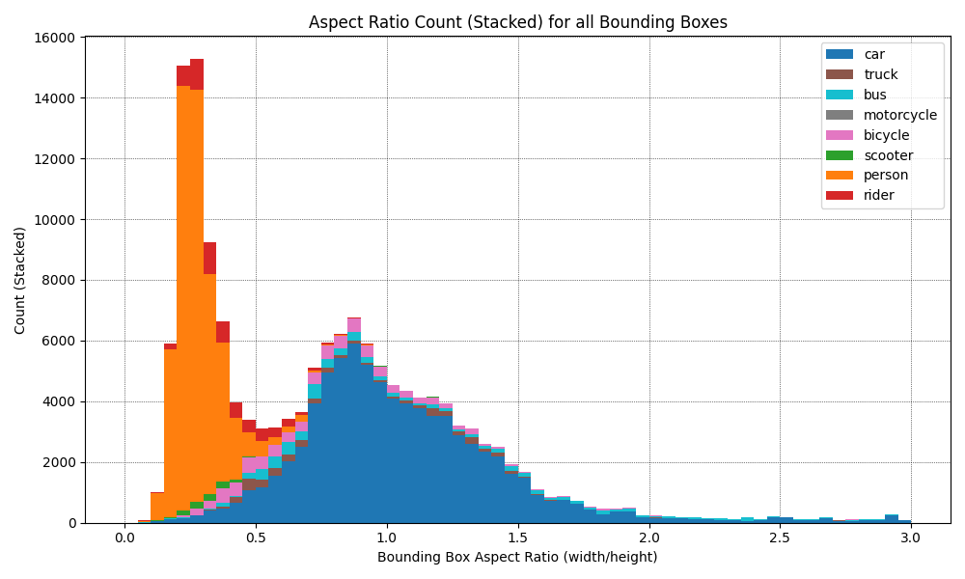
1.1 Dataset exploration – Aspect ratio train (Updated)
Notes:
This doesnt change when updating the dataset, but we see how the car and person classes turn into a normal distribution where persons have aspect ratios of mostly 0.25 and cars mostly around 1 (square)

Slide 9
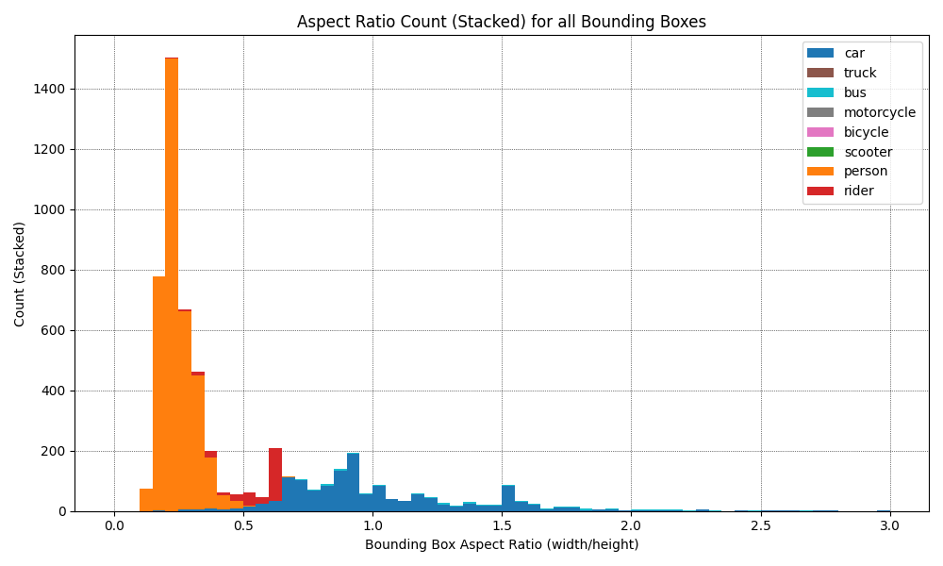
1.1 Dataset exploration – Aspect ratio Validation
Notes:
This is a different story for the vlidation set, the aspect ratios for persons remain the same, but the aspect ratios for the cars doesnt have a clear trend any longer, we also see a spike for riders which wasnt present before.

Slide 10
2.3 implementing retinanet
Notes:
Now lets look at the iterative implemntation of the FPN retinanet model

Slide 11
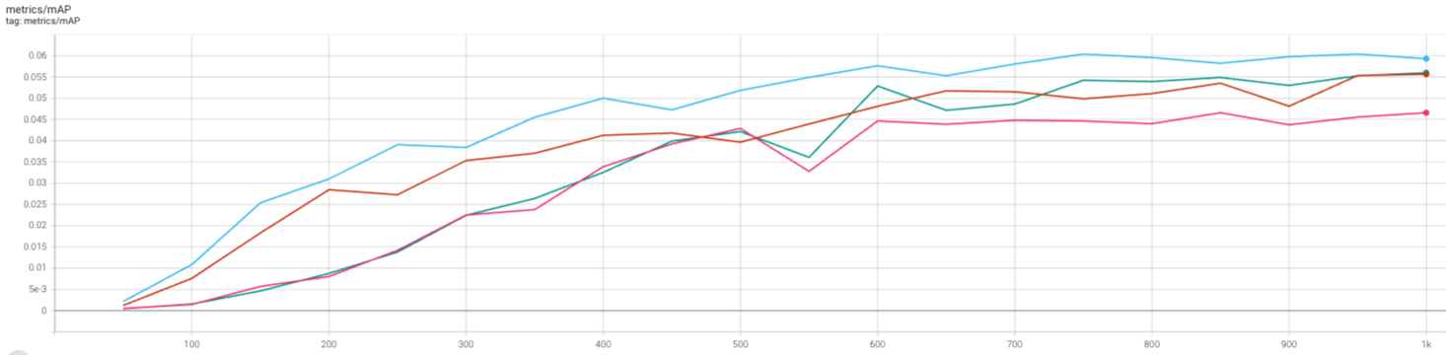
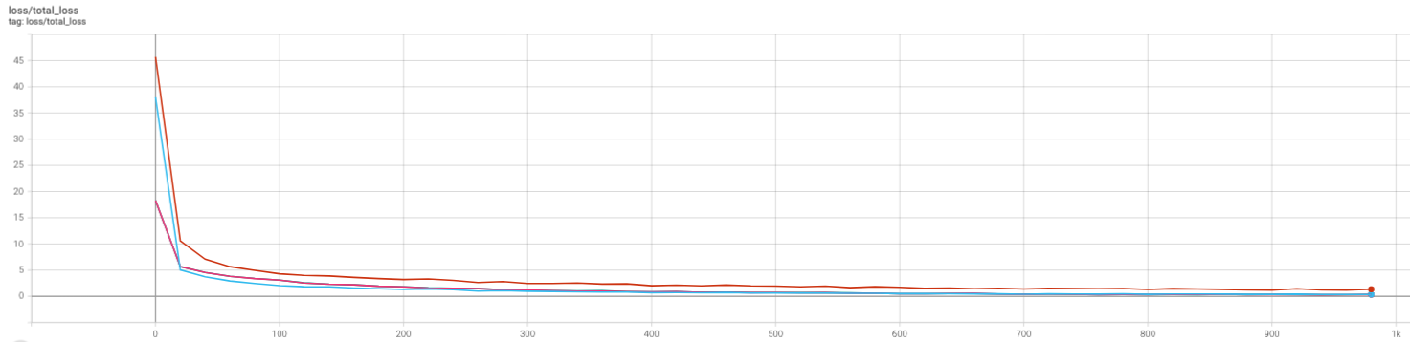
2.3 Implementing Retinanet
Brown = FPN
Blue = Focal Loss
Pink = Deep Heads
Green = Improved Init
Notes:
Here we see the mean average precision and loss after each improvement, firstly we have the brown line, which is only the fpn, which achieves a final mAP of 0.055 after 1000 iterations
next we add the focal loss with tthe blue graph, and the mAP increases drastically thrgouhout the entire traiing and end at almost 0.06.
Now when adding the the deep regression and classification heads the mAP actually decreases, this is likely due the fact that it will take a bit longer to train the parameters as there are a lot more of them, and increasing the number of iterations i trained the model could have given different results.
When improving the weight/bias initialization of the heads thoigh the mAp increases again, and is back to where it was without any changes. again most likely due the fact that the number of iterations is relatively small.

Slide 12
2.4 Using exploration knowledge

Slide 13
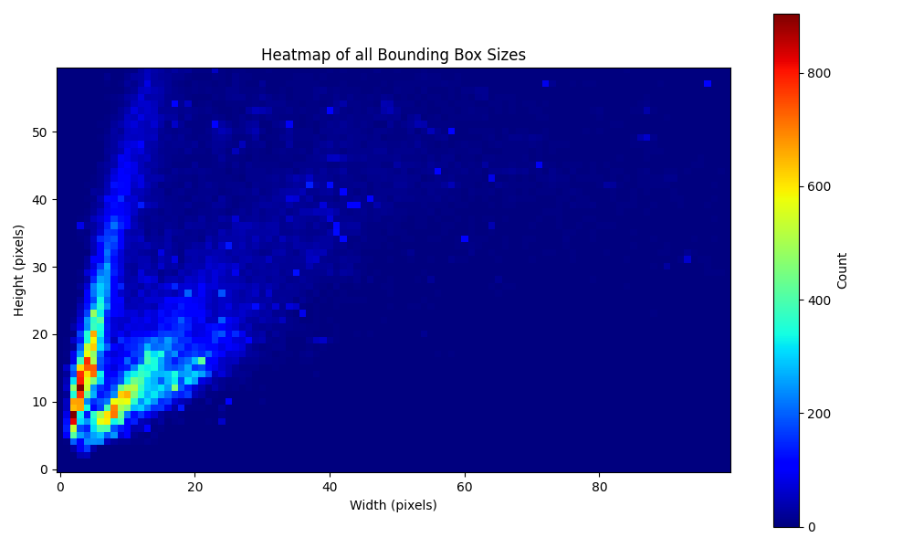
2.4 Using exploration knowledge
Notes:
I talked previously about the size of ratios of the bounding boxes, well to fit the model to the dataset i created this hetmap which shows the total number of bouncing boxes for each dimension.
We see that almost all bounding boxes are smaller than 30 pixels in with, and 50 pixels in height, and most of these are either square, or tall and narrow.
I wanted to adjust the bounding boxes to hit these "hot-spots" as best i could, however with limited time this was done with some rough calculations and estimation.

Slide 14
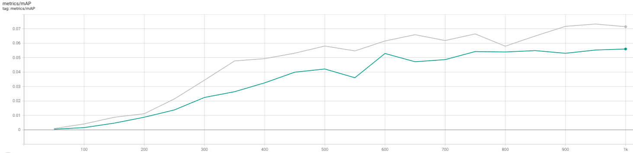
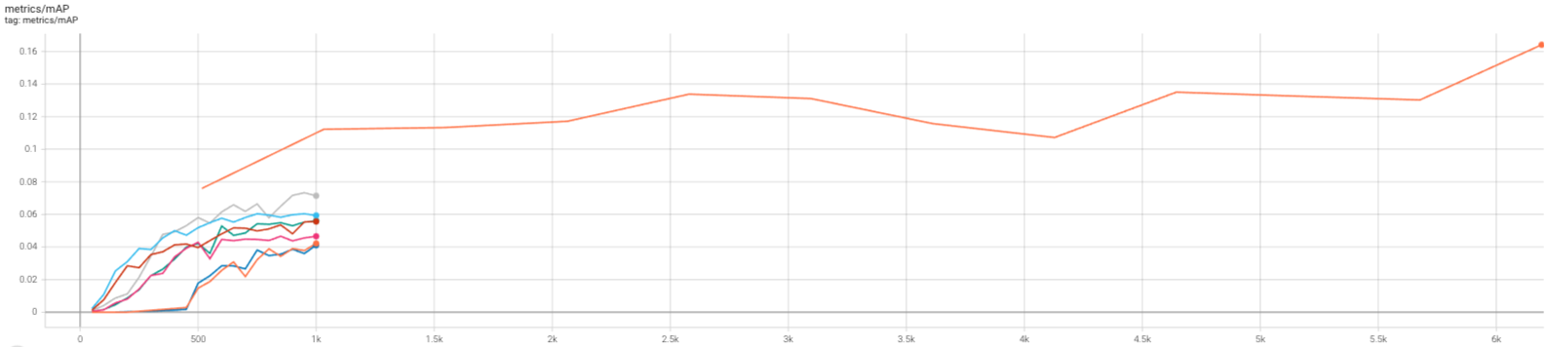
2.4 Using exploration knowledge
Notes:
My rough calculations seems to have done something though

Slide 15
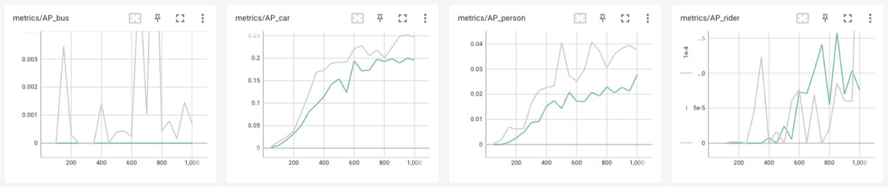
2.4 Using exploration knowledge
Notes:
My rough calculations seems to have done something though

Slide 16
Analysis and discussion

Slide 17
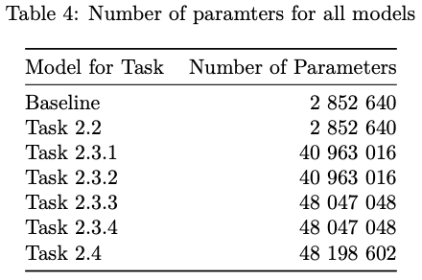
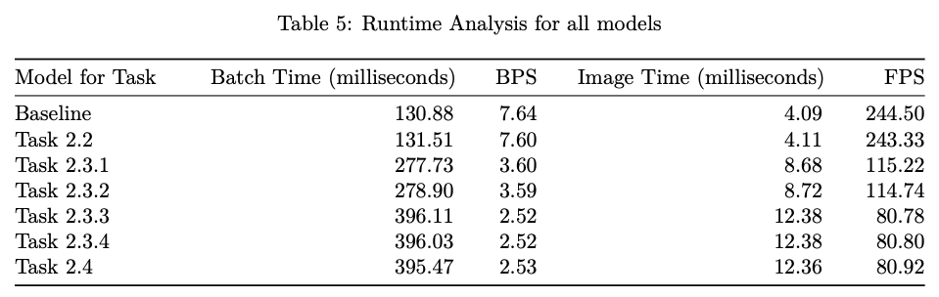
Performance impact
2.2 = Data Augmentation
2.3.1 = FPN
2.3.2 = Focal Loss
2.3.3 = Deep Heads
2.3.4 = Improved Init
2.4 = Using Exploration

Slide 18
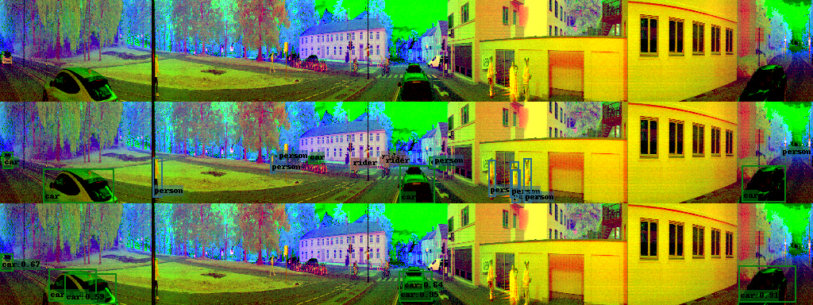
3.2 Qualitative Analysis – 2.1 Baseline

Slide 19
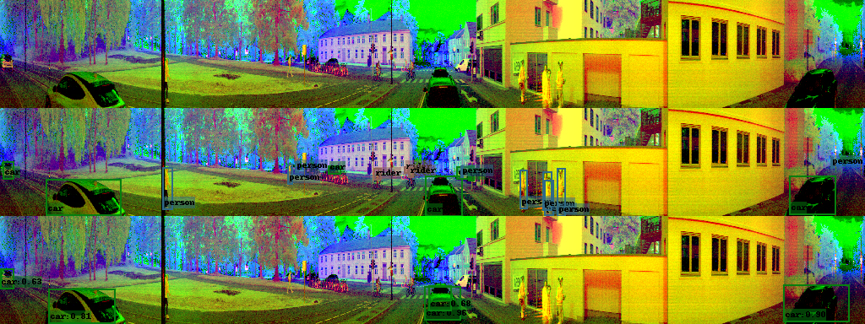
3.2 Qualitative Analysis – 2.2 Data Augmentation

Slide 20
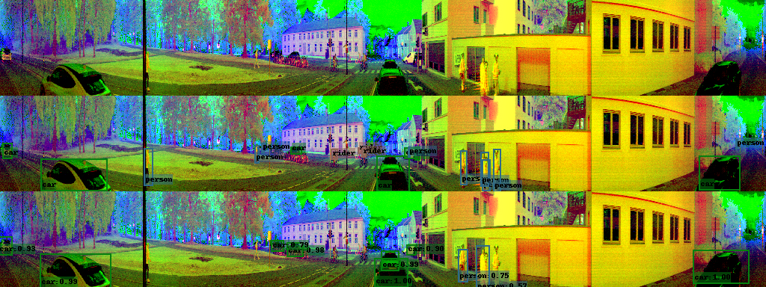
3.2 Qualitative Analysis – 2.3.1 FPN

Slide 21
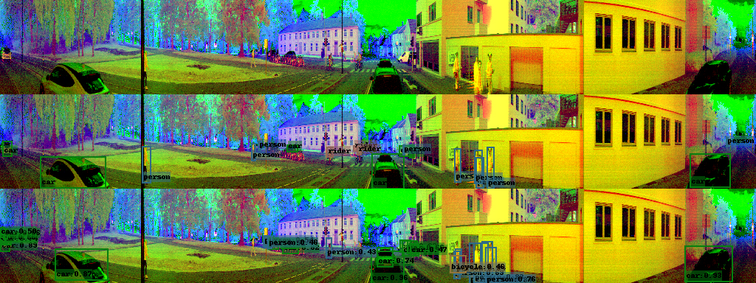
3.2 Qualitative Analysis – 2.3.2 Focal loss

Slide 22
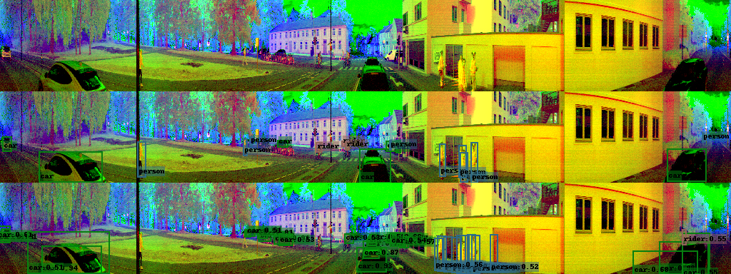
3.2 Qualitative Analysis – 2.3.3 Deep heads

Slide 23
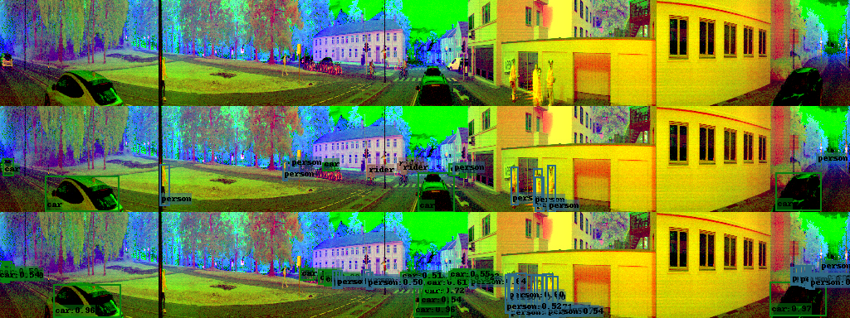
3.2 Qualitative Analysis – 2.3.4 Improved initialization

Slide 24
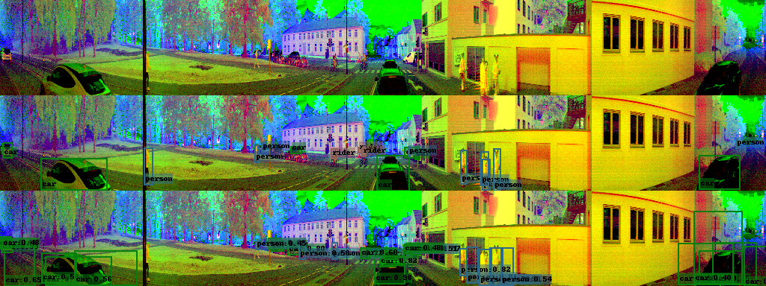
3.2 Qualitative Analysis – 2.4 Using exploration knowledge

Slide 25
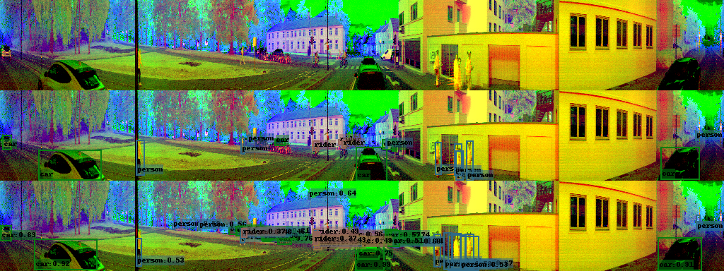
3.2 Qualitative Analysis – 2.5 Updated Dataset

Slide 26
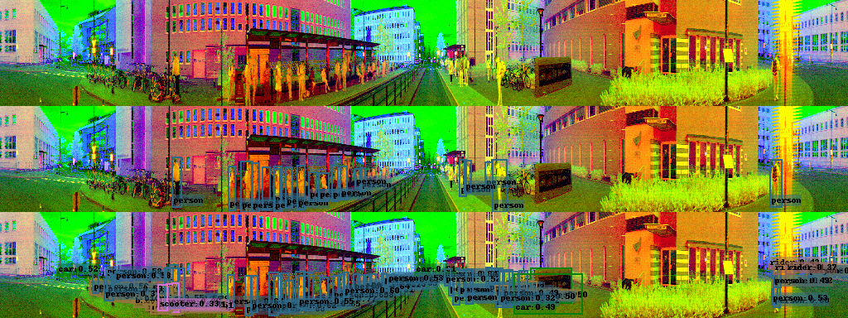
3.2 Qualitative Analysis – 2.5 Updated Dataset

Slide 27
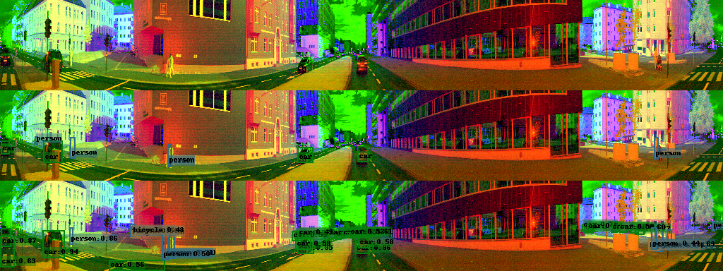
3.2 Qualitative Analysis – 2.5 Updated Dataset

Slide 28
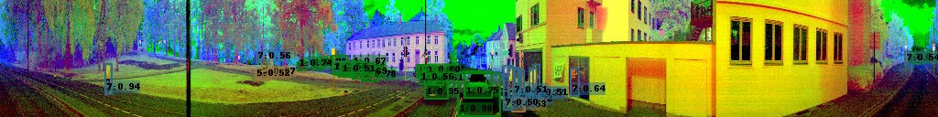
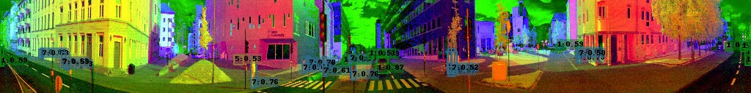
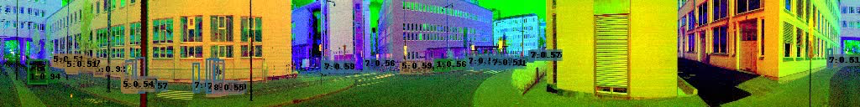
3.2 Qualitative Analysis – 2.5 Updated Dataset

Slide 29
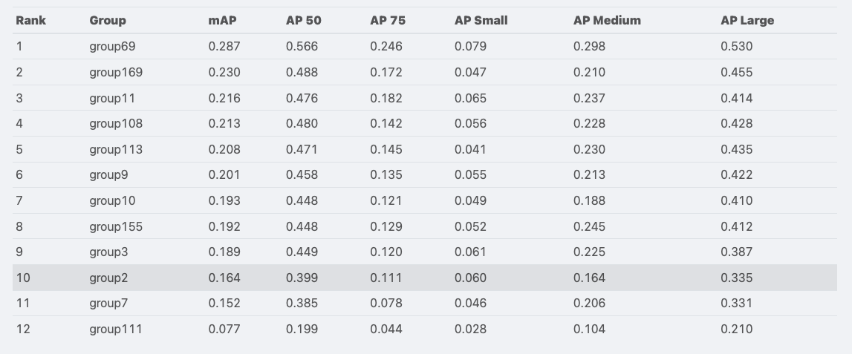
Final thoughts

